Slide 1


Global E-commerce Pitch for

Slide 2
Highlights
6 inventory Points
11 Sales channel
Covering 40 counties ( all major economies )
Creating multi million Dollar business vertical

Slide 3
Region covered
North America
United Kingdom
Europe
UAE and GCC country
Australia

Slide 4
Region wise Market Places
US | EU | MENA | Australia
Amazon | Amazon Uk | Amazon | Amazon
Walmart | Amazon France | Noon
Amazon Canada | Amazon Italy
Walmart Canada | Amazon Germany
 | Amazon Poland
 | amazon Netherlands
 | Amazon Sweden
 | On buy
 | Fruugo

Slide 5
Rollout Process
Account opening
Compliance
logistics and warehousing
Category Sales data analysis
Product assortment as per category analysis
Content and Creative
Listing and enhance brand content .
Go live

Slide 6
Account opening
Amazon global seller account will be opened.
This will be done with company’s Indian entity KYC documents, Banking and Tax details.
Common payment gateway will be Integrated to give consolidated payment in USD .
For other market places the registration must be region wise .

Slide 7
Compliance for operating business
All regions have different requirement
USA – No entity and no tax number required
Canada – No entity required , need VAT Number
UK – No entity required , need VAT Number
EU - No entity required , need VAT number .
Australia – No entity required no tax number .
UAE – need to do product registration, Entity formation and VAT . (This can be management by notional 3rd part)

Slide 8
Product compliance
Product compliance is Region wise.
A third party agency services will be used for compliance part and all certifications.

Slide 9
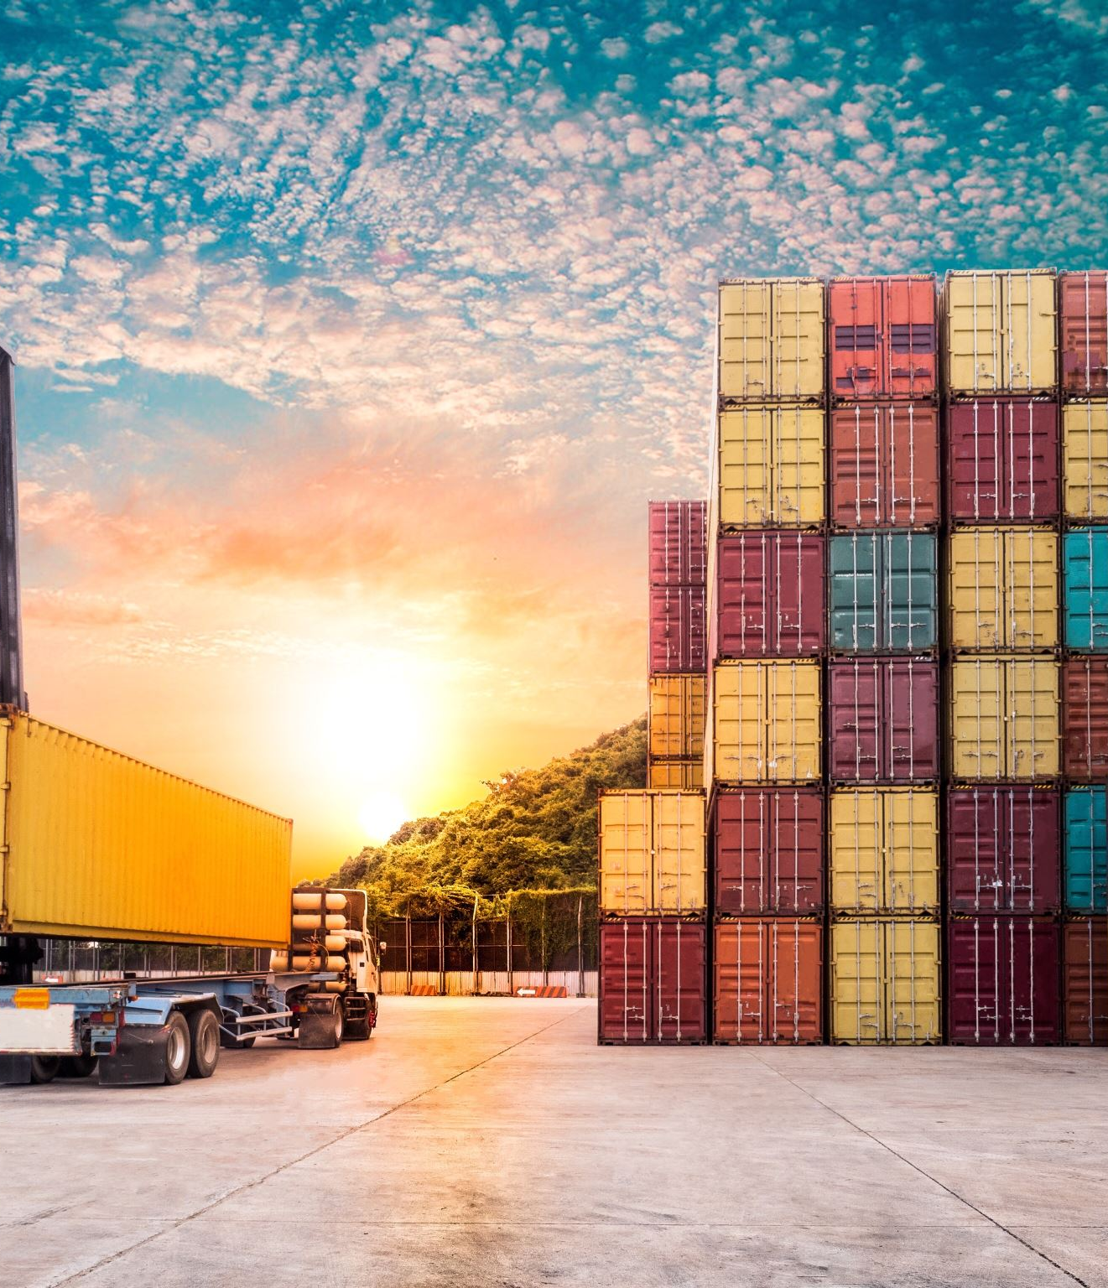
Logistics and warehouse
All good will be shipped by sea .
There are logistic partners who will take part shipment from your warehouse to destination warehouse .
Taking care of custom clearance at destination port
For amazon and Walmart, we will make consignment label in India and good will leave with consignment stickers .
As the business grow, we may require 3PL warehouse which will be aligned by our team region wise .

Slide 10
Product assortment
Market wise, category wise top seller and the sales data will be provided to for understanding market potential.
Based on this data we can match the product line
Once product is identified we do price benchmarking
To ensure product selling is viable, in the proposed price we will share markdown calculation to find net realization .
Bases this data we finalize assortment

Slide 11
Content and Creative
Once product line is finalized
Brand to share product information in specific CSV file or PIS file .
Basis the PIS we will make content and seed key words.
We will create listing creative, infographics, A + listing banner and infographics and finally the store front.
Store front is our brand website within marketplace website.
We need to create product videos and place them in listing / store front.

Slide 12
Go Live
Product are made – live
Once listing is done and inventory is aligned, we plan for marketing budget.
Advertisement campaign are set on portals.
Product review process starts.
Start Driving numbers
Optimize campaigns
Keep looking for deals, discounts and offering

Slide 13
Ten months Role Out Plan.
North America
01
UAE :
2nd to 3rd month
02
UK :
4th to 6th month
03
EU :
7th to 8th Month
04
Australia : 9th to 10th Month .
05

Slide 14

Our Role
On boarding
Images, creatives, videos, and Listing
Enhance brand content.
Paid marketing across the platforms.
Promotions and event planning
Product strategy - Assortment, pricing, combos etc.
SEO, Meta and Google AdWords. (where ever we plan)
Managing sales and operation for quick commerce.
Driving sales on web site.
E commerce operation - FBA consignment, panel Management and inventory management etc.
Reports and analysis

Slide 15

Let’s talk @ 74988-99232
ONE TEAM | ONE STRATEGY | ONE ACCOUNTABILITY.

